Slide 1
Computer Networks
OSI and TCP/IP Model
Arjav A. Bavarva

Slide 2
Layer Architecture
OSI Model
Layer architecture simplifies the network design.
It is easy to debug network applications in a layered architecture network.
The network management is easier due to the layered architecture.
Network layers follow a set of rules, called protocol.
The protocol defines the format of the data being exchanged, and the control and timing for the handshake between layers.

Slide 3
Open Systems Interconnection (OSI) Model
OSI Model
International standard organization (ISO) established a committee in 1977 to develop an architecture for computer communication.
Open Systems Interconnection (OSI) reference model is the result of this effort.
In 1984, the Open Systems Interconnection (OSI) reference model was approved as an international standard for communications architecture.
Term “open” denotes the ability to connect any two systems which conform to the reference model and associated standards.

Slide 4
OSI Reference Model
OSI Model
The OSI model is now considered the primary Architectural model for inter-computer communications.
The OSI model describes how information or data makes its way from application programmes (such as spreadsheets) through a network medium (such as wire) to another application programme located on another network.
The OSI reference model divides the problem of moving information between computers over a network medium into SEVEN smaller and more manageable problems .
This separation into smaller more manageable functions is known as layering.

Slide 5
OSI: A Layered Network Model
The process of breaking up the functions or tasks of networking into layers reduces complexity.
Each layer provides a service to the layer above it in the protocol specification.
Each layer communicates with the same layer’s software or hardware on other computers.
The lower 4 layers (transport, network, data link and physical —Layers 4, 3, 2, and 1) are concerned with the flow of data from end to end through the network.
The upper four layers of the OSI model (application, presentation and session—Layers 7, 6 and 5) are orientated more toward services to the applications.
Data is Encapsulated with the necessary protocol information as it moves down the layers before network transit.

Slide 6
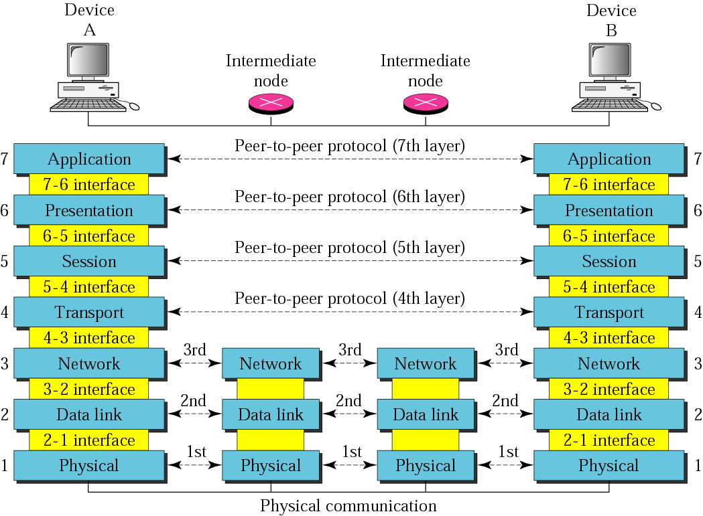
OSI layers
TCP/IP Protocol Suite

Slide 7
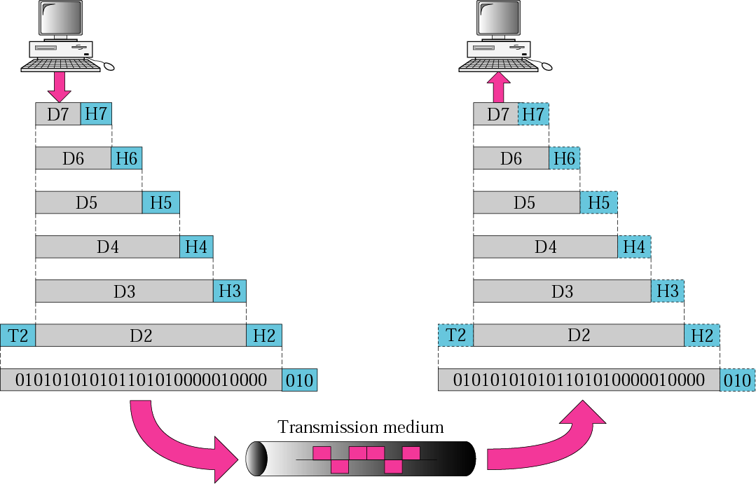
An exchange using the OSI model

Slide 8
Physical Layer
OSI Model
Provides physical interface for transmission of information.
Converts bits into electronic signals for outgoing messages and electronic signals into bits for incoming messages
QoS
This layer manages the interface between the computer and the network medium (coax, twisted pair, etc.)
Covers all - mechanical, electrical and functional - aspects for physical communication.
Such characteristics as voltage levels, timing of voltage changes, physical data rates, maximum transmission distances, physical connectors, and other similar attributes are defined by physical layer specifications.

Slide 9
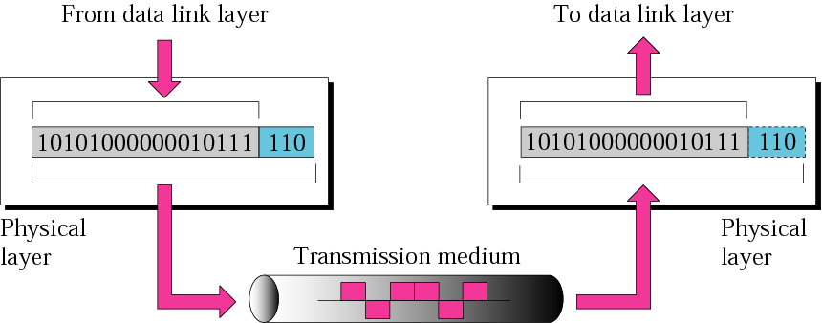
Physical Layer

Slide 10
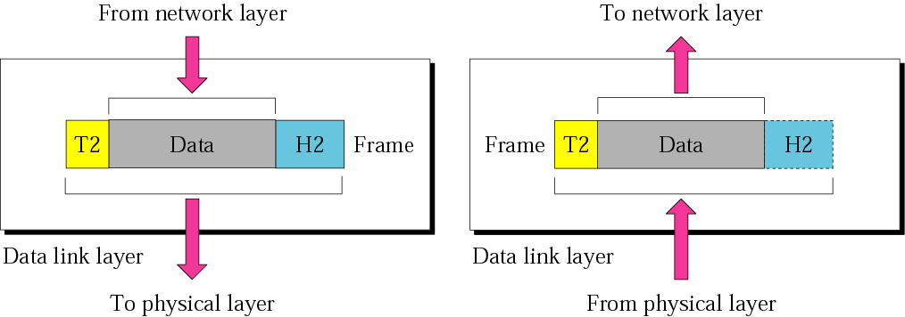
Data Link Layer

Slide 11
Data Link Layer
OSI Model
Data link layer attempts to provide reliable communication (error free) over the physical layer interface.
Breaks the outgoing data into frames and reassemble the received frames.
Create and detect frame boundaries. (Trailer)
Handle errors by implementing an acknowledgement and retransmission scheme.
Implement flow control.
Supports points-to-point as well as broadcast communication.
Supports simplex, half-duplex or full-duplex communication.

Slide 12
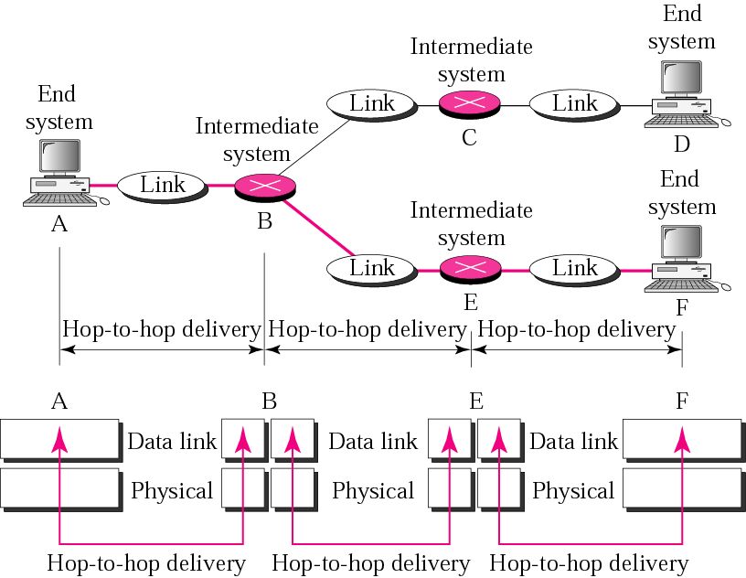
Data Link Layer

Slide 13
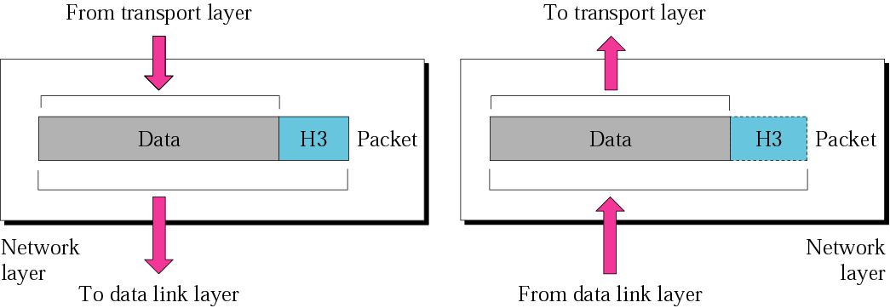
Network Layer

Slide 14
Network Layer
OSI Model
Implements routing of packets through the network.
Defines the most optimum path the packet should take from the source to the destination
Defines logical addressing so that any endpoint can be identified.
Handles congestion in the network.
Facilitates interconnection between heterogeneous networks (Internetworking).
QoS (delay, transit time etc.)
In broadcast network, the routing problem is simple, so the network layer is often thin or even nonexistent.

Slide 15
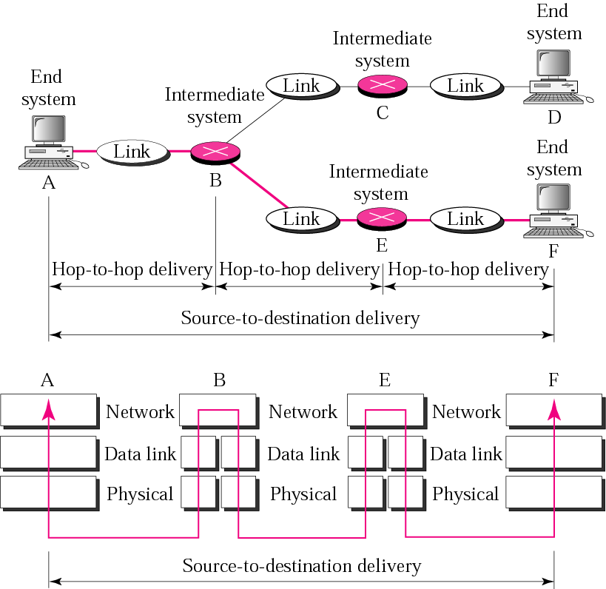
Network Layer

Slide 16
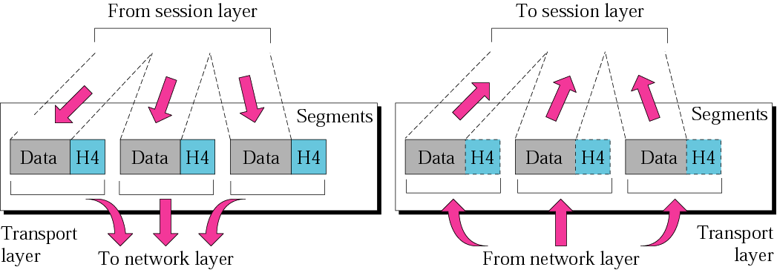
Transport Layer

Slide 17
Transport Layer
OSI Model
Purpose of this layer is to provide a reliable mechanism for the exchange of data between two processes in different computers.
Ensures that the data units are delivered error free.
Ensures that data units are delivered in sequence.
Ensures that there is no loss or duplication of data units.
Provides connectionless or connection oriented service.
Provides for the connection management.
Multiplex multiple connection over a single channel.
In short, responsible for deliver the message

Slide 18
Session Layer
OSI Model
Session layer provides mechanism for controlling the dialogue between the two end systems. It defines how to start, control and end conversations (called sessions) between applications.
Keeping track of whose turn it is to transmit.
Any necessary log-on or password validation is also handled by this layer.
Token management – preventing two parties from attempting same critical operation at a same time.
Synchronization

Slide 19
Presentation Layer
OSI Model
Presentation layer defines the format in which the data is to be exchanged between the two communicating entities.
Also handles data translation, compression and data encryption (cryptography).

Slide 20
Application Layer
OSI Model
Application layer interacts with application programs and is the highest level of OSI model.
Application layer contains management functions to support distributed applications.
Examples of application layer are applications such as file transfer, electronic mail, remote login etc.

Slide 21


Slide 22
OSI and TCP/IP model
OSI
TCP / IP
Application (Layer7)
Application
Presentation (Layer6)
Session (Layer 5)
Transport (Layer 4)
Transport
Network (Layer 3)
Internet
Data Link (Layer 2)
Data link layer (Subnet)
Physical (Layer 1)

Slide 23
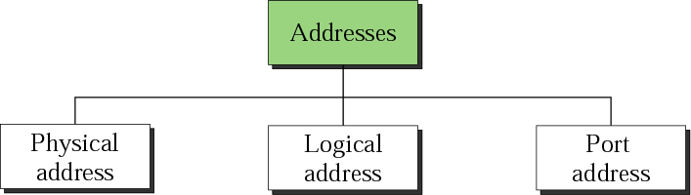
Addressing

Slide 24
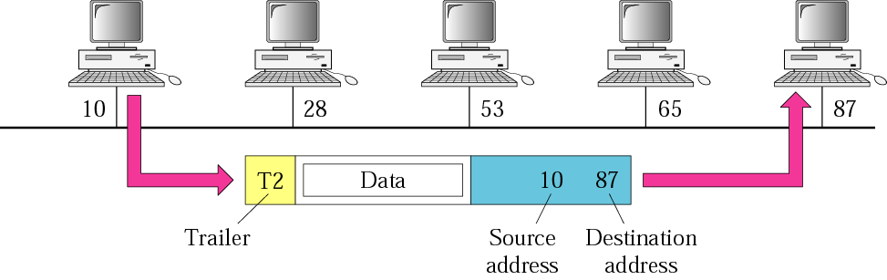
Physical addresses
The trailer usually contains extra bits needed for error detection.

Slide 25
Physical addresses
Most local area networks use a 48-bit (6 bytes) physical address written as 12 hexadecimal digits, with every 2 bytes separated by a colon as shown below:
07:01:02:01:2C:4B
A 6-byte (12 hexadecimal digits) physical address.

Slide 26
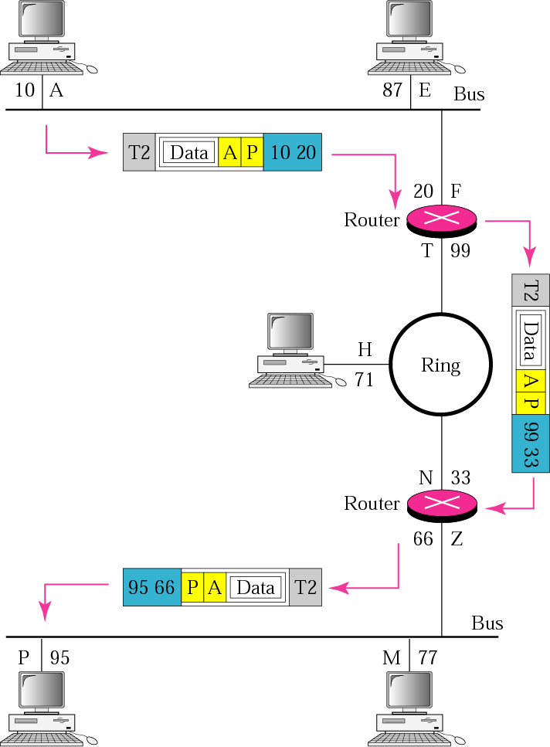
Logical address (IP addresses)

Slide 27
Logical address (IP addresses)
An Internet address (in IPv4) is 32 bits in length, normally written as four decimal numbers, with each number representing 1 byte. The numbers are separated by a dot. Below is an example of such an address.
132.24.75.9
An internet address in IPv4 in decimal numbers

Slide 28
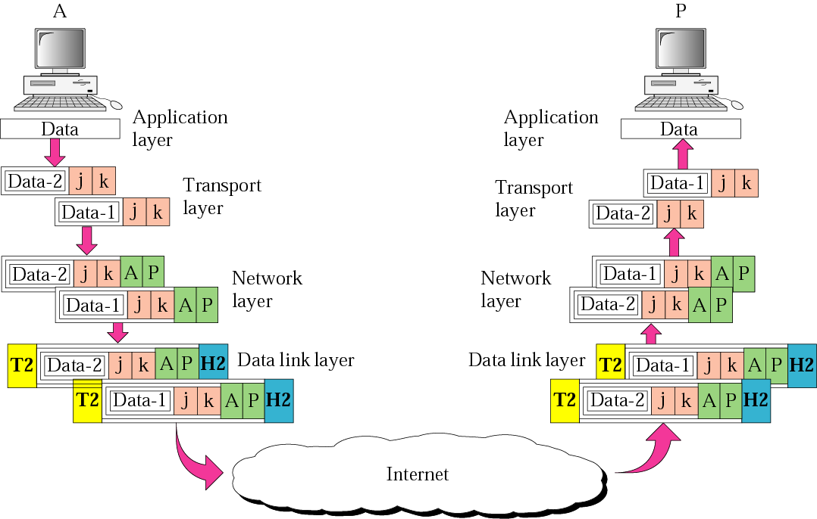
Port addresses

Slide 29
Port addresses
A port address is a 16-bit address represented by one decimal number as shown below.
753
A 16-bit port address represented as one single number.

